Slide 1

Module 6
Logistic Regression
Notes:
Guidelines
Use section headers to chunk content in your presentation.
Use the same style of section header throughout your presentation.
Keep your title to no more than 2 lines.

Slide 2
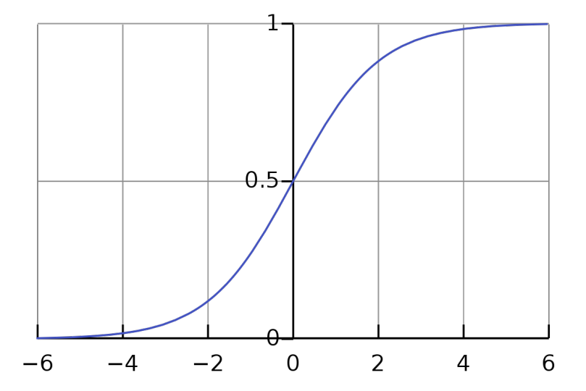
Logistic Regression Probability, Odds, Log(odds)
Notes:
Guidelines
Use a title slide at the beginning of your presentation. There are 9 variations of title slides to choose from.
If you will have a series of slideshows, we recommend using the same style of title slide for each presentation.
Keep your title to no more than 2 lines.
Do not change the font style or font size of the title or subtitle.

Slide 3
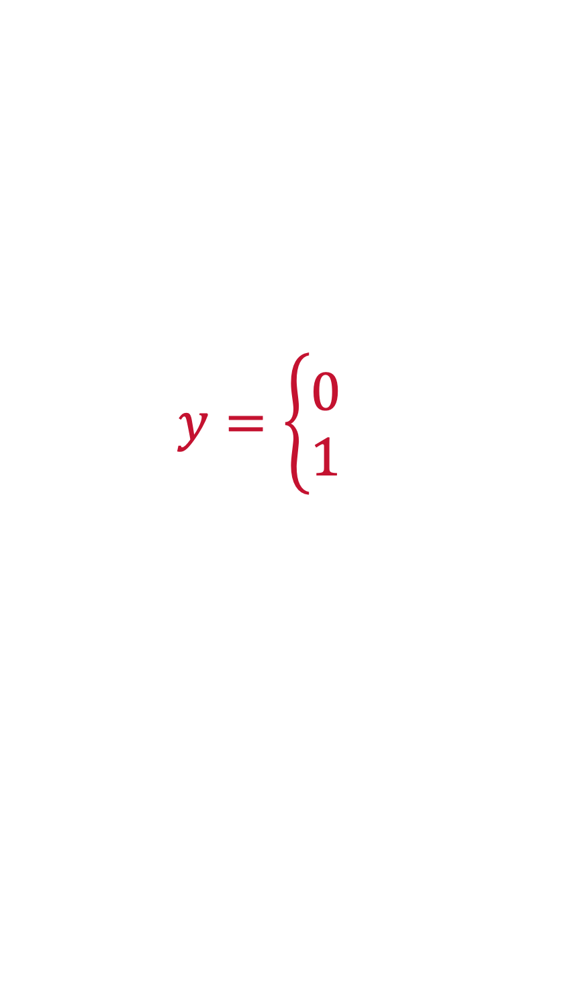
Logistic Regression
Logistic regression is a linear model used for binary classification
The response is encoded to 0 and 1.
1: assigned to the level of interest, 0: the remaining level
$$y=\left\{\begin{aligned}0 \\ 1\end{aligned}\right.$$

Slide 4
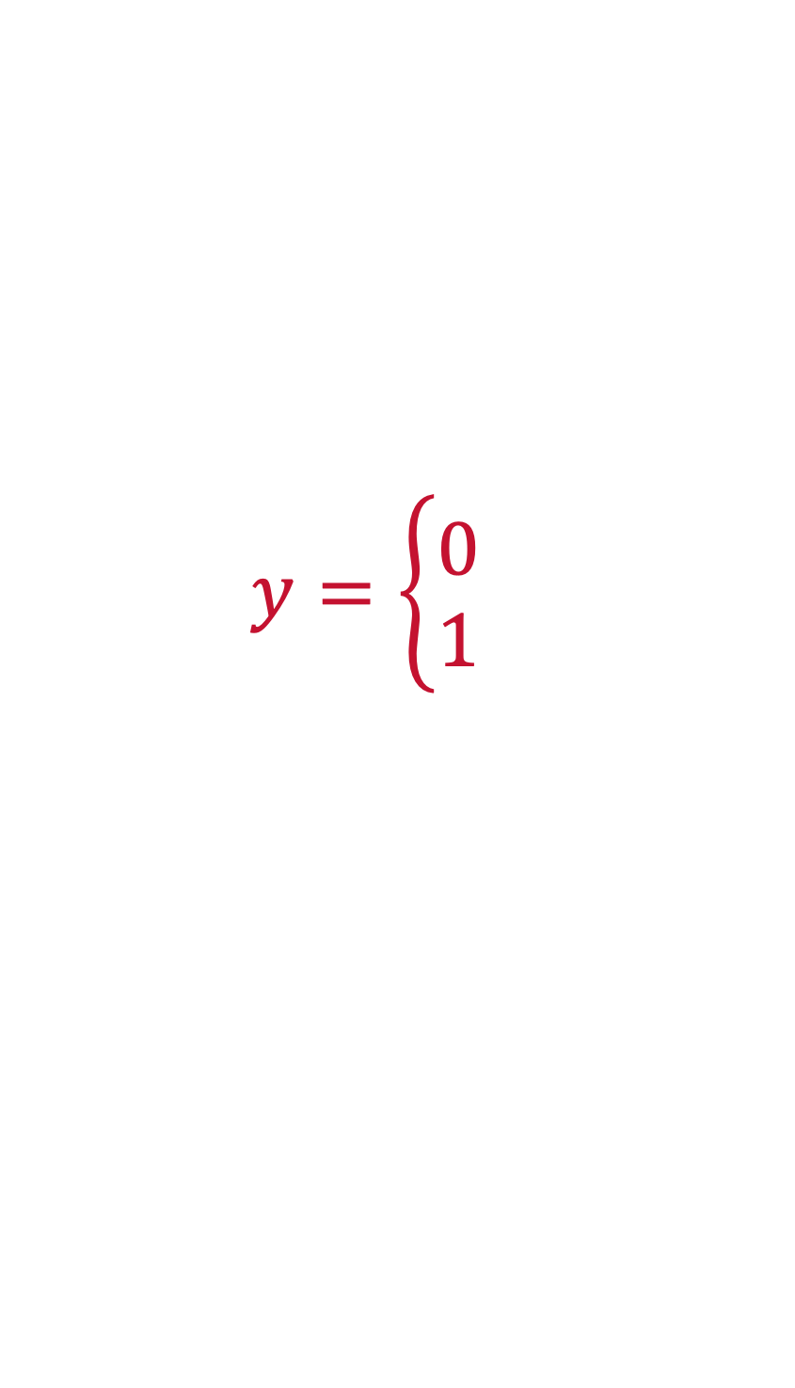
Logistic Regression
Examples of Binary Classification
Will a customer buy or not buy a product?
Is a loan applicant a low or high credit risk?
Will a user engage with a marketing email?
$$y=\left\{\begin{aligned}0 \\ 1\end{aligned}\right.$$

Slide 5
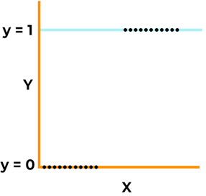

Logistic Regression
Generalization of the linear regression model

Slide 6
Logistic Regression
Linear Regression assumptions would not hold
The assumptions regarding 𝜖 are:
The mean of 𝜖 is zero or 𝐸(𝜖)=0
The variance of 𝜖 is constant 𝜎2 or 𝑣𝑎𝑟(𝜖)= 𝜎2
The 𝜖 is normally distributed or 𝜖 𝑁(0, 𝜎2)
The 𝜖s are independent

Slide 7
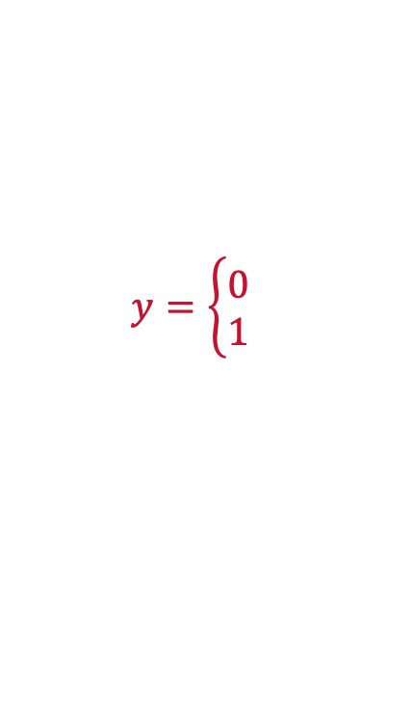
Logistic Regression
Linear Regression assumptions would not hold
$$y=\left\{\begin{aligned}0 \\ 1\end{aligned}\right.$$
The error terms are non-normal.
The variance of 𝜖 is not constant across different values of the response.
The equation above has no constraints on the value of y that it will predict, 𝑦̂ .

Slide 8
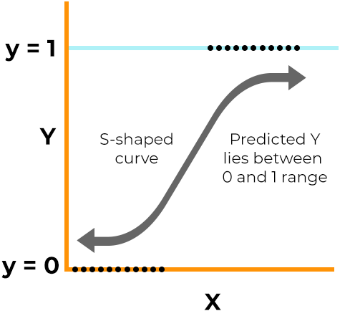
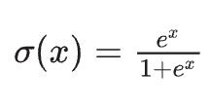

Logistic Regression
We need a model that
requires that the predicted responses will be between 0 and 1 and
does not have normal distribution and constant variance assumptions
LOGISTIC TRANSFORMATION

Slide 9
Python
Notes:
Guidelines
Use a title slide at the beginning of your presentation. There are 9 variations of title slides to choose from.
If you will have a series of slideshows, we recommend using the same style of title slide for each presentation.
Keep your title to no more than 2 lines.
Do not change the font style or font size of the title or subtitle.

Slide 10
Logistic Regression
We need a model that
requires that the predicted responses will be between 0 and 1 and
does not have normal distribution and constant variance assumptions
LINK

Slide 11
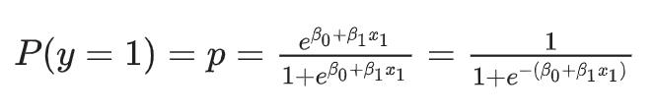
Logistic Regression
We need a model that
requires that the predicted responses will be between 0 and 1 and
does not have normal distribution and constant variance assumptions
LINK

Slide 12
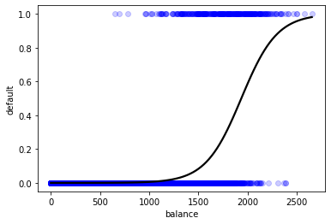
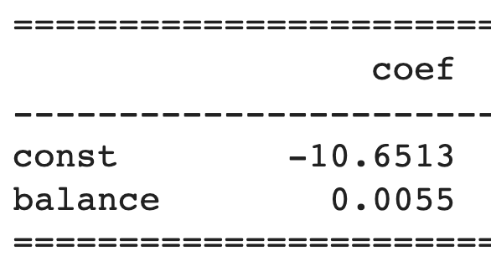


Predictions
Predictions are made in the form of propensities
$$\hat{y}=−10.6513+0.0055balance$$

Slide 13
Python
Notes:
Guidelines
Use a title slide at the beginning of your presentation. There are 9 variations of title slides to choose from.
If you will have a series of slideshows, we recommend using the same style of title slide for each presentation.
Keep your title to no more than 2 lines.
Do not change the font style or font size of the title or subtitle.

Slide 14
Log(odds)
Notes:
Guidelines
Use a title slide at the beginning of your presentation. There are 9 variations of title slides to choose from.
If you will have a series of slideshows, we recommend using the same style of title slide for each presentation.
Keep your title to no more than 2 lines.
Do not change the font style or font size of the title or subtitle.

Slide 15
Calculating Predictions
What are the log(odds) of default for a balance of $1,500
$$Log\left(odds\right)of Default=−10.6513+0.0055balance$$

Slide 16
Python
Notes:
Guidelines
Use a title slide at the beginning of your presentation. There are 9 variations of title slides to choose from.
If you will have a series of slideshows, we recommend using the same style of title slide for each presentation.
Keep your title to no more than 2 lines.
Do not change the font style or font size of the title or subtitle.

Slide 17
Probability
Notes:
Guidelines
Use a title slide at the beginning of your presentation. There are 9 variations of title slides to choose from.
If you will have a series of slideshows, we recommend using the same style of title slide for each presentation.
Keep your title to no more than 2 lines.
Do not change the font style or font size of the title or subtitle.

Slide 18
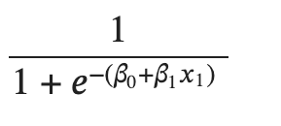
Calculating Probabilities
Predict the probability of default for a balance of $1,500
$$Log\left(odds\right)of Default=−10.6513+0.0055balance$$

Slide 19
Calculating Probabilities
Predict the probability of default for a balance of $2,000
$$Log\left(odds\right)of Default=−10.6513+0.0055balance$$

Slide 20
Python
Notes:
Guidelines
Use a title slide at the beginning of your presentation. There are 9 variations of title slides to choose from.
If you will have a series of slideshows, we recommend using the same style of title slide for each presentation.
Keep your title to no more than 2 lines.
Do not change the font style or font size of the title or subtitle.

Slide 21
Odds
Notes:
Guidelines
Use a title slide at the beginning of your presentation. There are 9 variations of title slides to choose from.
If you will have a series of slideshows, we recommend using the same style of title slide for each presentation.
Keep your title to no more than 2 lines.
Do not change the font style or font size of the title or subtitle.

Slide 22
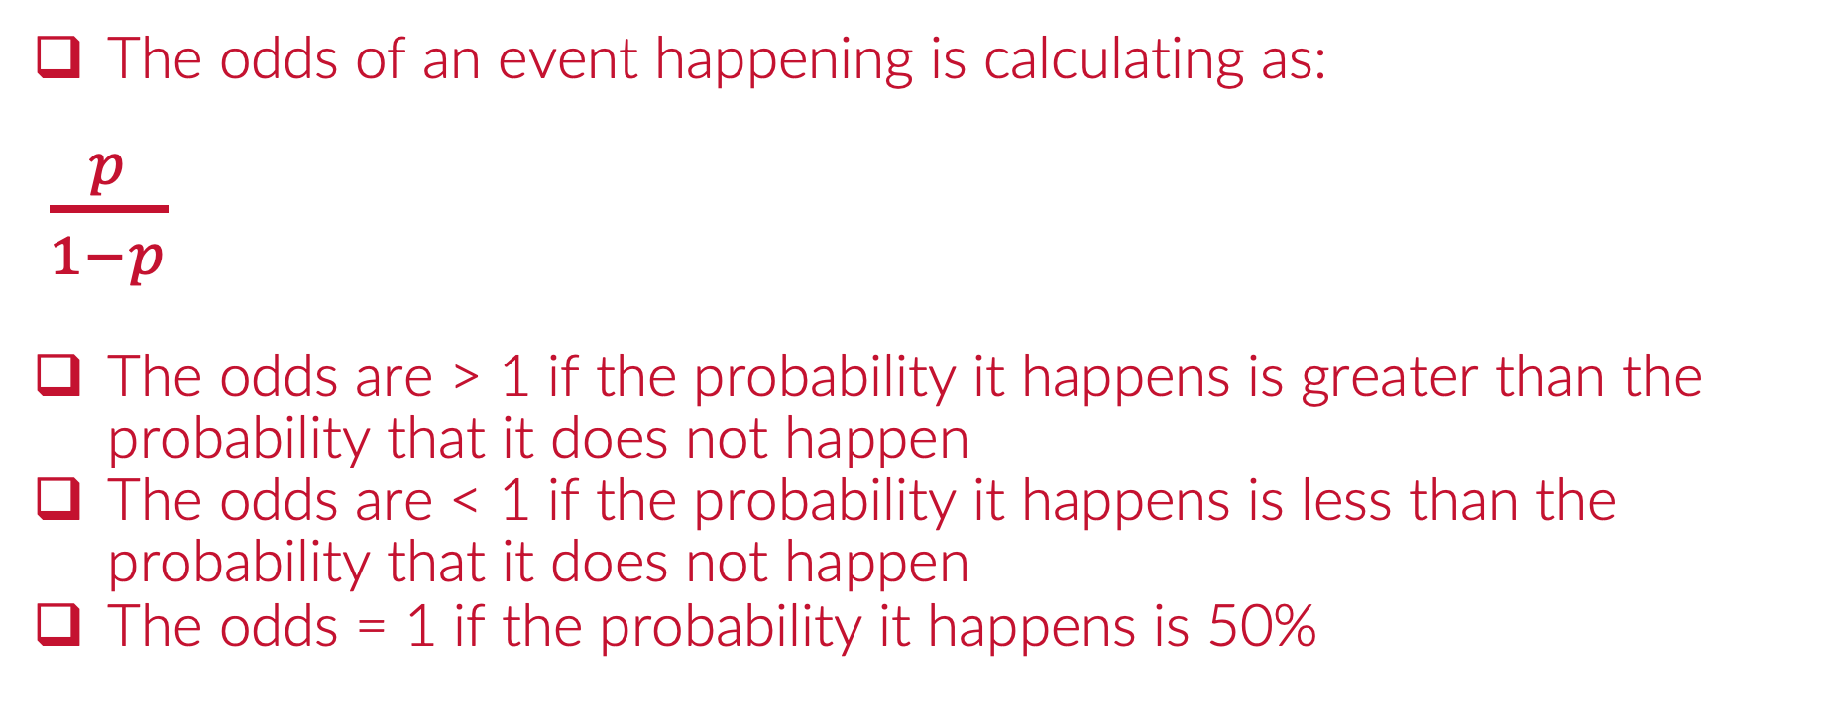
Calculating the Odds of Default
The odds of an event happening is calculating as:
$\frac{p}{1−p}$
The odds are > 1 if the probability it happens is greater than the probability that it does not happen
The odds are < 1 if the probability it happens is less than the probability that it does not happen
The odds = 1 if the probability it happens is 50%

Slide 23
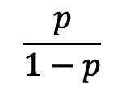

Calculating the Odds
What are the odds of default for a balance of $2,000?
$$p=$$
$$\frac{p}{1−p}$$

Slide 24
Calculating the Odds
What are the odds of default for a balance of $1,937?
$$p=$$
$$\frac{p}{1−p}$$

Slide 25
Python
Notes:
Guidelines
Use a title slide at the beginning of your presentation. There are 9 variations of title slides to choose from.
If you will have a series of slideshows, we recommend using the same style of title slide for each presentation.
Keep your title to no more than 2 lines.
Do not change the font style or font size of the title or subtitle.

Slide 26
Other Relationships
Notes:
Guidelines
Use a title slide at the beginning of your presentation. There are 9 variations of title slides to choose from.
If you will have a series of slideshows, we recommend using the same style of title slide for each presentation.
Keep your title to no more than 2 lines.
Do not change the font style or font size of the title or subtitle.

Slide 27
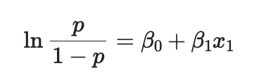


Important Odds Relationships
The log odds of the event happening is the regression equation

Slide 28
Python
Notes:
Guidelines
Use a title slide at the beginning of your presentation. There are 9 variations of title slides to choose from.
If you will have a series of slideshows, we recommend using the same style of title slide for each presentation.
Keep your title to no more than 2 lines.
Do not change the font style or font size of the title or subtitle.

Slide 29
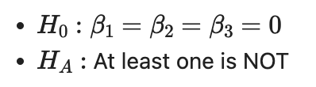
Goodness of Fit Metrics
As with linear regression we first want to evaluate the overall usefulness of the model
The overall test for goodness of fit uses the Deviance statistic and is called the LLR test
The LLR test is equivalent to the F-statistic p-value of linear regression

Slide 30
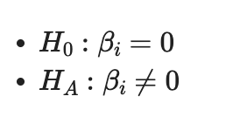
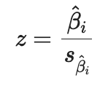
Goodness of Fit Metrics
The null and alternative hypothesis tests for each predictor is
The p-value is the probability of observing a statistic as extreme as the one observed given that the null hypothesis is true.

Slide 31
Convergence
Parameter estimates are typically obtained by maximum likelihood estimation (iterative process)

Slide 32
Python
Notes:
Guidelines
Use a title slide at the beginning of your presentation. There are 9 variations of title slides to choose from.
If you will have a series of slideshows, we recommend using the same style of title slide for each presentation.
Keep your title to no more than 2 lines.
Do not change the font style or font size of the title or subtitle.

Slide 33
Descriptive LR Model Example
Goal: Understand Relationships with Coronary Heart Disease (CHD)
male: male(0) or female(1);(Nominal)
age: age of the patienteducation
currentSmoker: whether or not the patient is a current smoker (Nominal)
cigsPerDay: the number of cigarettes that the person smoked on average in one day
BPMeds: whether or not the patient was on blood pressure medication (Nominal)
prevalentStroke: whether or not the patient had previously had a stroke (Nominal)
prevalentHyp: whether or not the patient was hypertensive (Nominal)
diabetes: whether or not the patient had diabetes (Nominal)
totChol: total cholesterol level (Continuous)
sysBP: systolic blood pressure (Continuous)
diaBP: diastolic blood pressure (Continuous)
BMI: Body Mass Index (Continuous)
heartRate: heart rate (Continuous)
glucose: glucose level (Continuous)
10 year risk of coronary heart disease CHD (binary: “1”, means “Yes”, “0” means “No”) - Target Variable

Slide 34
Python
Notes:
Guidelines
Use a title slide at the beginning of your presentation. There are 9 variations of title slides to choose from.
If you will have a series of slideshows, we recommend using the same style of title slide for each presentation.
Keep your title to no more than 2 lines.
Do not change the font style or font size of the title or subtitle.

Slide 35
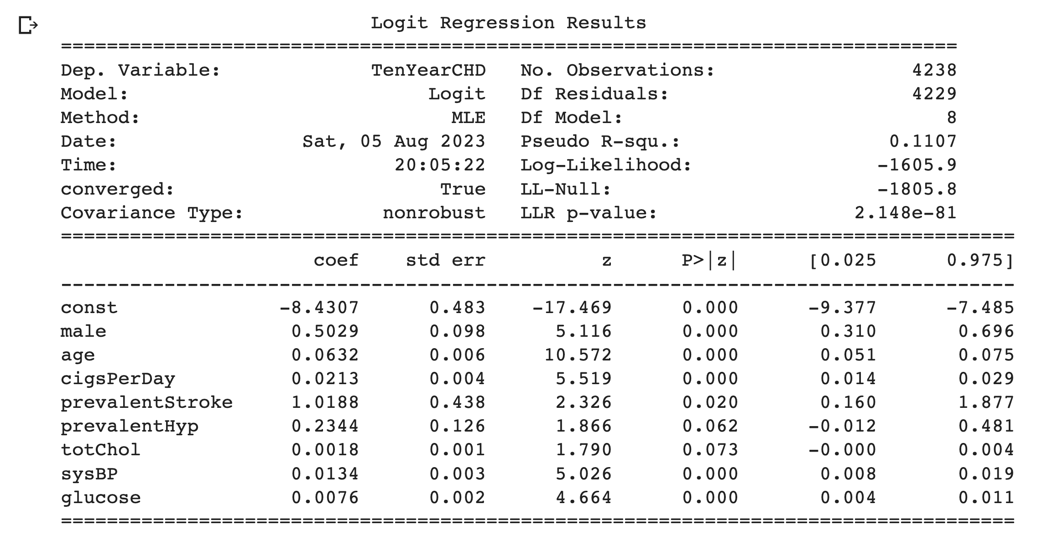
Descriptive LR Model Example
Goal: Predict Coronary Heart Disease (CHD)

